Slide 1
Email Spam Classification Using NLP and Machine Learning
PRESENTED BY:
Anagha Jayarajan
A Muhammed Khaise
Ananthan S
PREDICTIVE ANALYTICS
APRIL 2026

Slide 2
Content
1
Problem statement
2
Dataset overview
3
Methodology and pipeline
4
Model comparison
5
Deployed application
6
Conclusion, limitation & future work

Slide 3
Problem Statement:
Email spam has become a significant challenge in modern communication systems, overwhelming users with unwanted and often harmful messages.
Pose serious risks through phishing attacks, financial fraud, and misleading advertisements. As the volume of digital communication continues to grow,
Manually filtering such messages is inefficient and impractical.
Critical need for automated systems that can accurately classify emails into spam and legitimate (ham) categories.
Implementing intelligent spam detection using Natural Language Processing (NLP) and Machine Learning helps improve user experience, enhances security, and protects individuals and organizations from potential cyber threats.

Slide 4
Dataset Overview:
Enron dataset
Originally released during the investigation of the Enron Corporation scandal
Contains real-world emails from Enron employees
Available in structured format on Hugging Face for easy use in ML project
Typical columns include:
Text—Email content
Label—Spam or ham(0=ham,1=spam)
Typical columns include:
text → Email content
label → Spam or Ham (0 = Ham, 1 = Spam

Slide 5
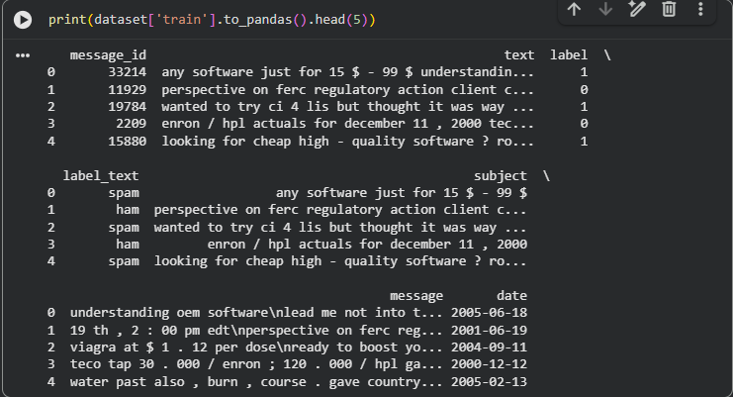
Fig 1: Dataset overview

Slide 6
The dataset has 31716 rows and 7 columns.
The summary of columns and datatypes include:
message_id: Integer, 31716 non-null values.
text: Object (string), 31716 non-null values.
label: Integer, 31716 non-null values.
label_text: Object (string), 31716 non-null values.
subject: Object (string), 31716 non-null values.
message: Object (string), 31716 non-null values.
date: Datetime, 31716 non-null values.
There are no missing values in any column.
Typical columns include:
text → Email content
label → Spam or Ham (0 = Ham, 1 = Spam

Slide 7
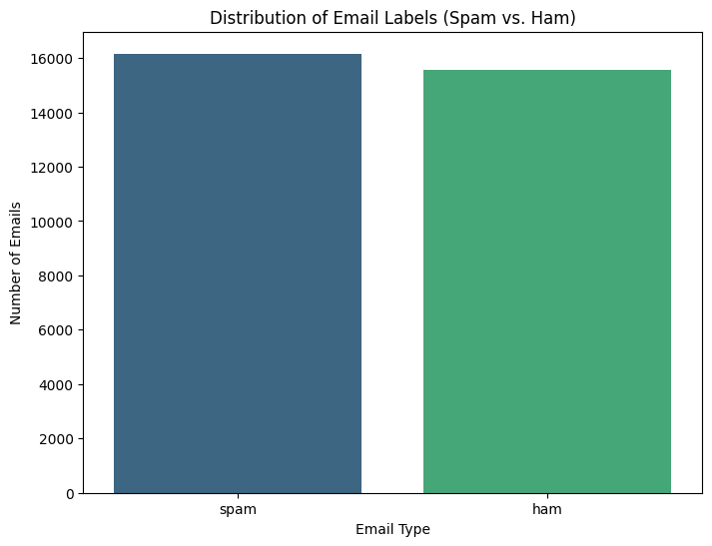
Fig 2: Class Distribution

Slide 8
Methodology:
Load the Enron dataset from Hugging Face
Preprocess the text(Cleaning, tokenization, stop-word removal and lemmatization)
Feature extraction techniques: TF-IDF and word embeddings
Three different models were trained:
Naive bayes–baseline probabilistic model
Support vector machine–High performance classifier with calibrated probabilities
LSTM–Deep learning model capturing context
Evaluate each model with accuracy , F1 score and confusion matrices
Streamlit-based application to deploy the trained model
Typical columns include:
text → Email content
label → Spam or Ham (0 = Ham, 1 = Spam

Slide 9
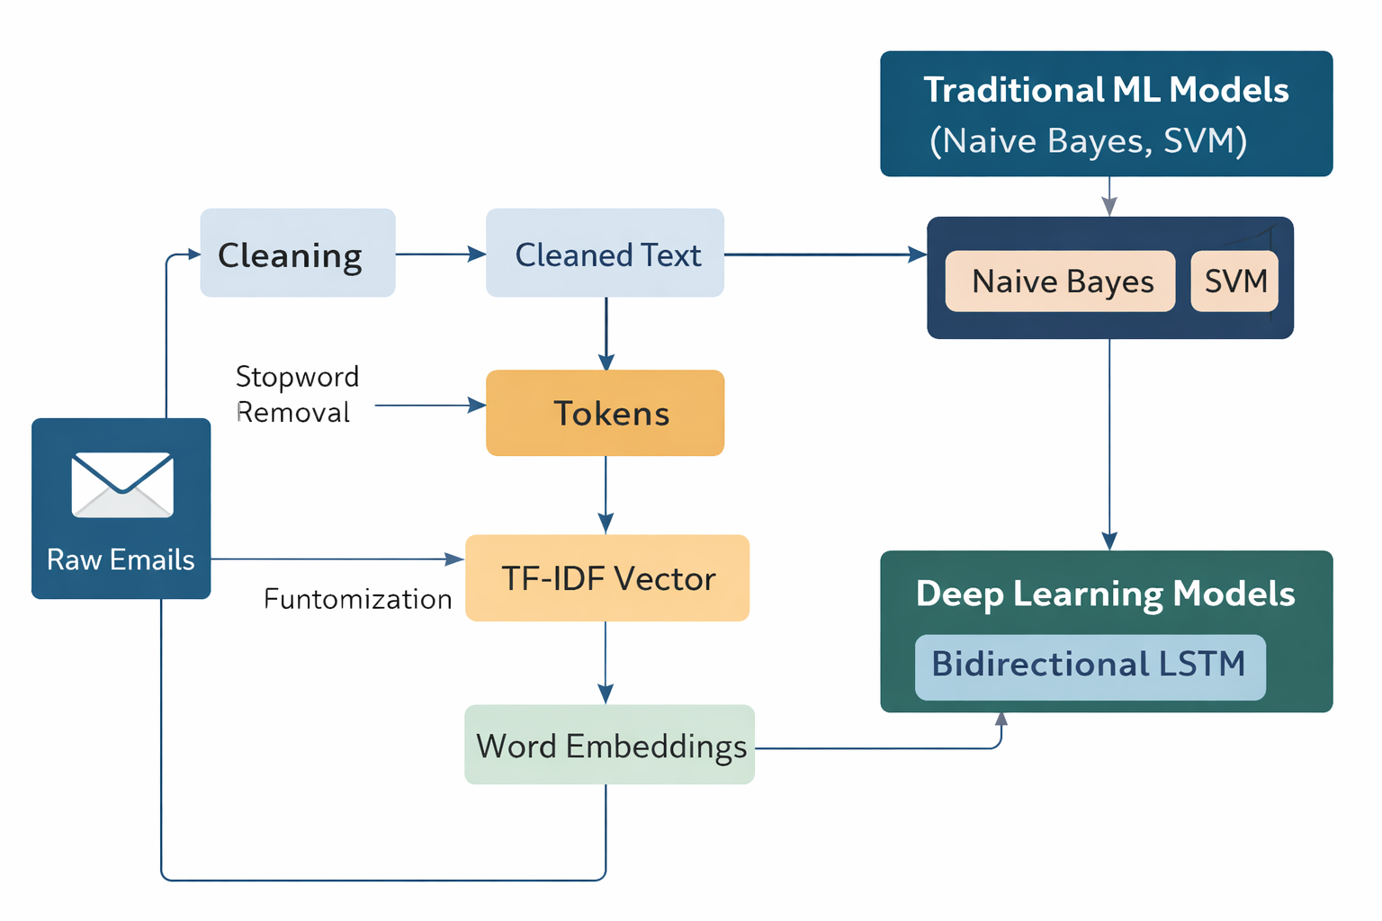
Fig 3: Pipeline diagram

Slide 10
Model Performance comparison
Model
Accuracy
Precision
Recall
F1
Naive Bayes
0.9809
0.98
0.98
0.98
SVM
0.9191
0.9558
0.7769
0.8571
LSTM
0.9397
0.94
0.94
0.9043

Slide 11
CONFUSION MATRICES

Slide 12
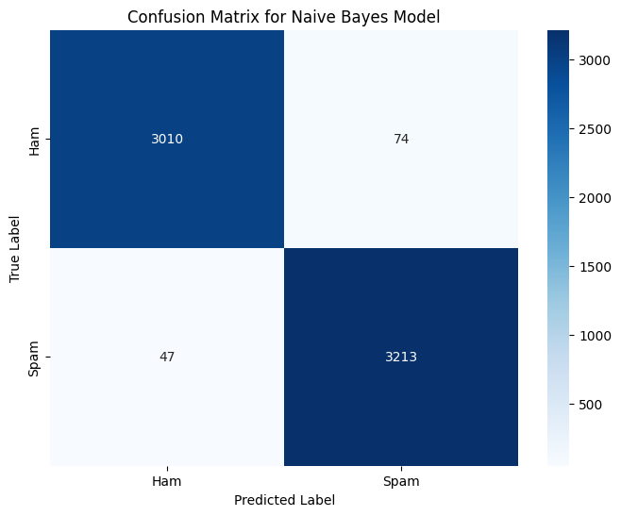
Fig 5: Confusion matrix of Naive Bayes model

Slide 13
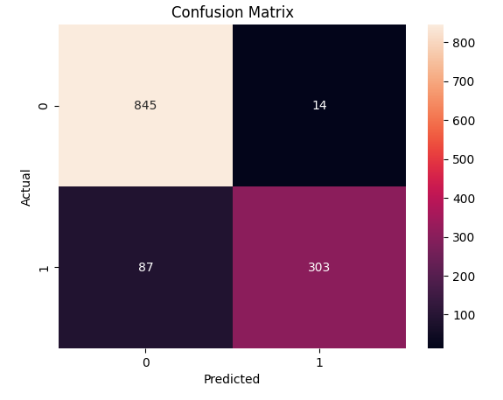
Fig 5: Confusion matrix of SVM model

Slide 14
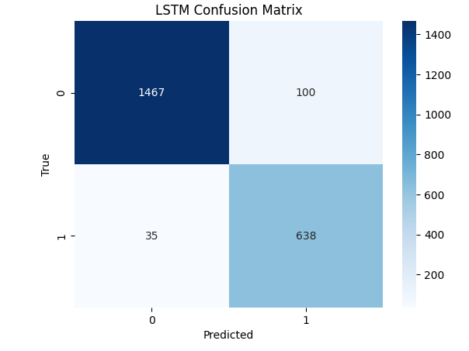
Fig 6: Confusion matrix of LSTM model

Slide 15
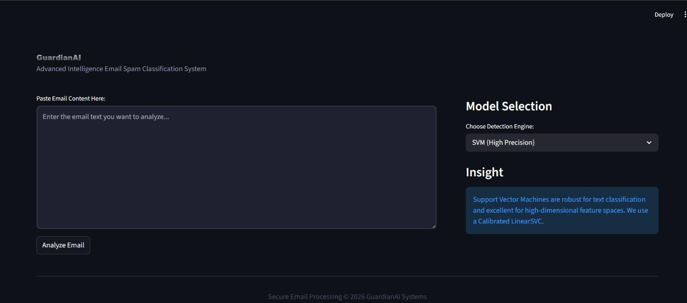
DEPLOYED APPLICATION:

Slide 16
Conclusion:
Successfully developed an email spam classification model using NLP and machine learning techniques
Among the three models tested, Naive Bayes outperforms both SVM and LSTM across all metrics — achieving the highest scores in Accuracy (0.9809), Precision (0.98), Recall (0.98), and F1 (0.98).
Naive Bayes achieves F1 = 0.98 because both its Precision and Recall are equally high at 0.98 — meaning it has:
Very few False Positives → high Precision
Very few False Negatives → high Recall
Typical columns include:
text → Email content
label → Spam or Ham (0 = Ham, 1 = Spam

Slide 17
This is a text classification task, where Naive Bayes tends to excel because:
Feature independence assumption fits text well — word frequencies are treated independently, which works surprisingly effectively for language data
Works well with smaller/cleaner datasets — no overfitting risk
Less sensitive to irrelevant features — probabilistic smoothing helps
SVM and LSTM need more tuning — LSTM especially requires large data and careful hyperparameter tuning to reach its potential
text → Email content
label → Spam or Ham (0 = Ham, 1 = Spam

Slide 18
Limitations:
Despite the high performance, the current system has a few constraints:
Dataset Specificity: The models were trained on a specific dataset. Their performance might degrade when faced with radically different email formats or highly specialized domains (e.g., medical or legal spam) not represented in the training data.
Computational Complexity: The Bidirectional LSTM, while highly accurate, requires more computational power and time to train and deploy compared to simpler models like Naive Bayes.
Static Nature: The models are trained on static data and may struggle with "adversarial spam"—new techniques used by spammers to bypass filters, such as using images or unusual character encodings.
Typical columns include:
text → Email content
label → Spam or Ham (0 = Ham, 1 = Spam

Slide 19
Future Works:
Hybrid models: Integrate Attention mechanisms or BERT to improve context and semantic detection.
Multi-model analysis: Expand beyond text to scan attachments and embedded links for phishing.
Real-time Learning: Enable the model to auto-update as users mark new emails as spam.
Production Scaling: Transition the Streamlit app to a cloud-hosted API for high-volume, real-time filtering

Slide 20
Thank you
PREDICTIVE ANALYTICS
APRIL 2026

